Slide 1
Quantum Computing Architectures (EE274) Lecture 11
Hiu-Yung Wong
feb. 27, 2025
hiuyung.wong@sjsu.edu, Office: ENG363
http://www.sjsu.edu/people/hiuyung.wong/index.html

Slide 2
Outline
Schroedinger Equation, Spin, and Quantum Gate
Spin Angular Momentum Operator
Rabi Oscillation

Slide 3
Schroedinger Equation
Chapter 4, Chapter 7, Chapter 8 of “Quantum Computing Architecture and Hardware for Engineers: Step by Step”

Slide 4
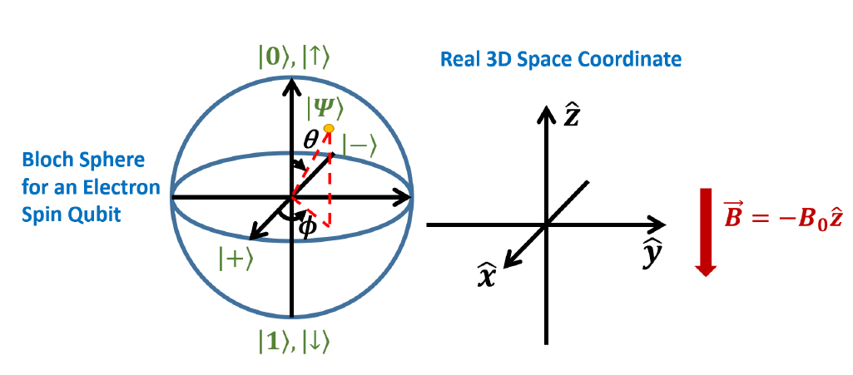
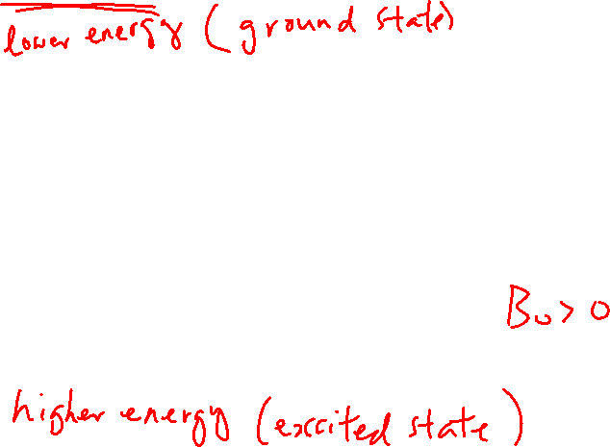
Bloch Sphere Representation of the Spin State (electron)
From the last lecture
Learning outcomes: Relationship to the 3D space

Slide 5
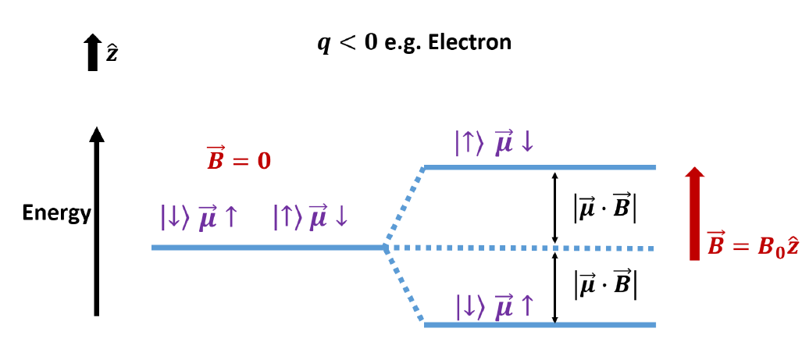

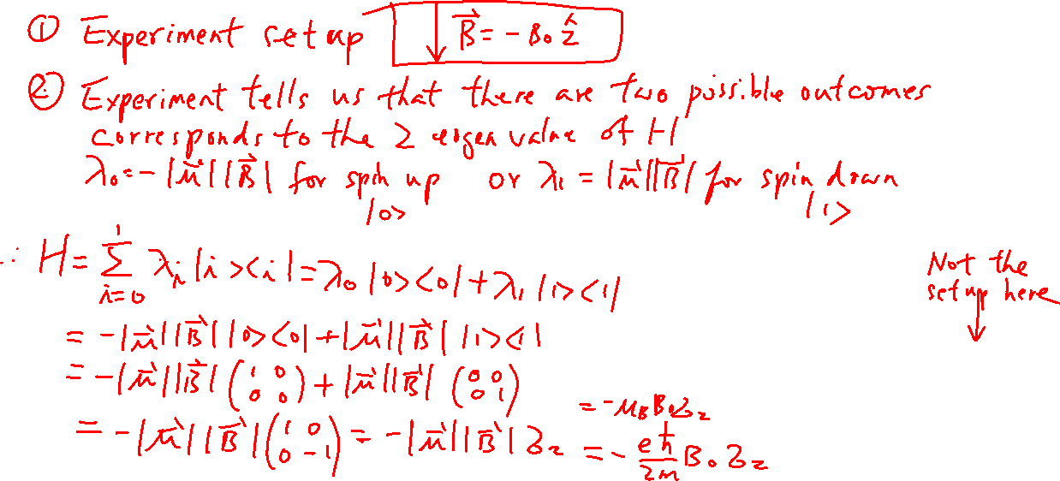
Construction of Hamiltonian
From the last lecture
Learning outcomes: Understand the interaction Hamiltonian

Slide 6
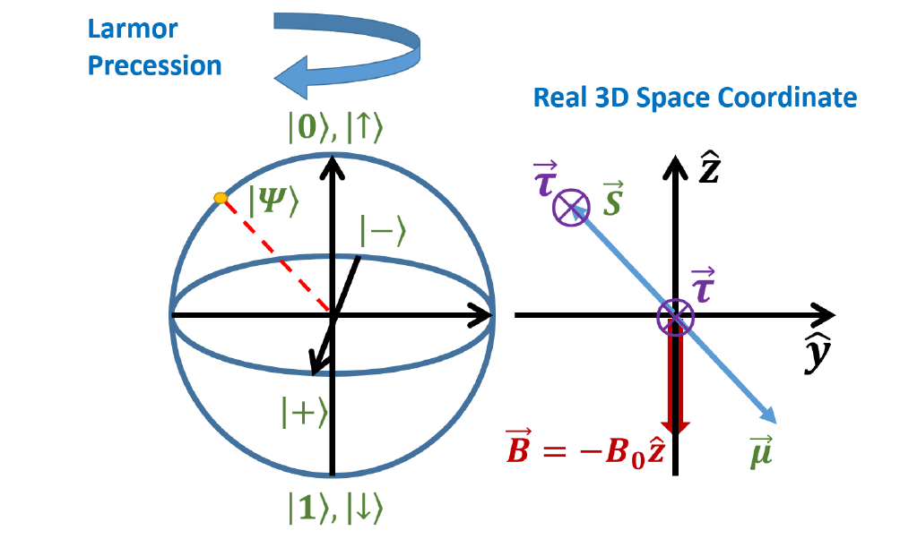
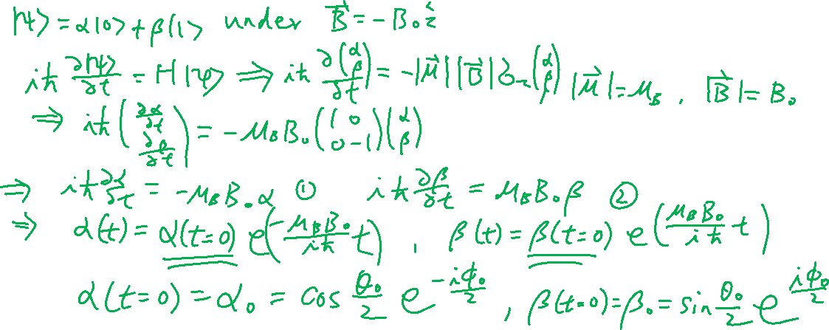
Larmor Precession – Our first physical implementation of a quantum gate – Phase Shift Gate
Learning outcomes: Understand the physics

Slide 7
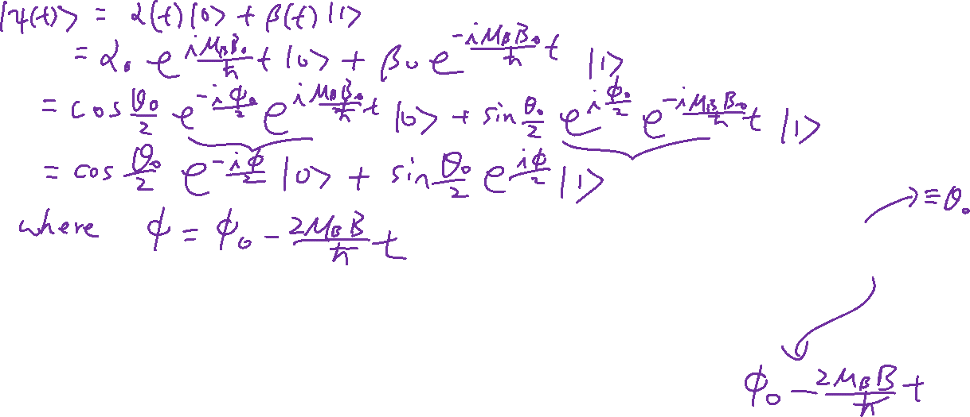
Larmor Precession – Our first physical implementation of a quantum gate – Phase Shift Gate

Slide 8
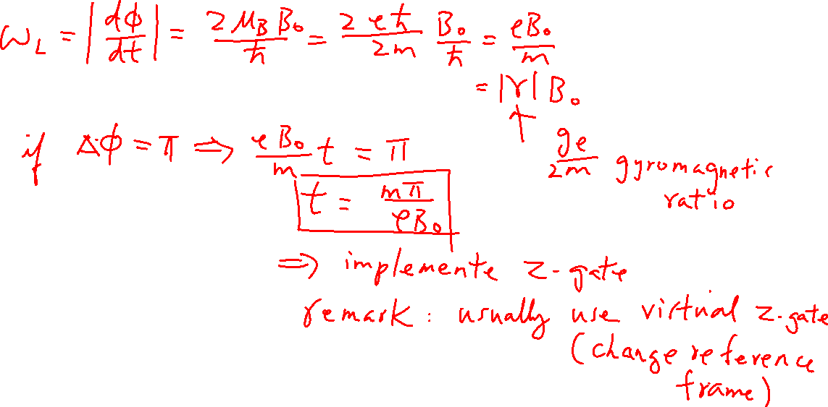
Larmor Frequency
Learning outcomes: Definition

Slide 9
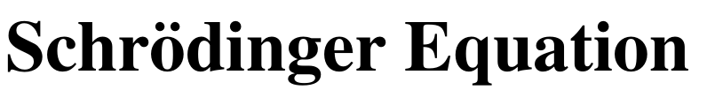
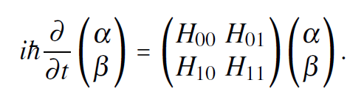

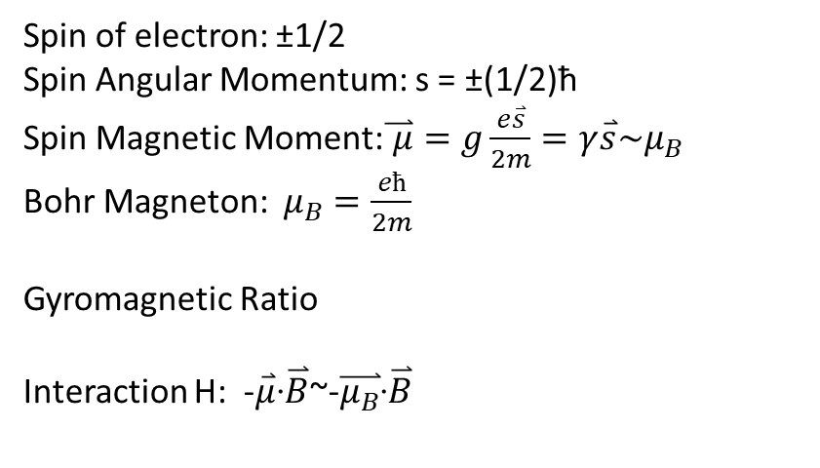
Summary
Spin of electron: ±1/2
Spin Angular Momentum: s = ±(1/2)ħ
Spin Magnetic Moment:$\overset{⃑}{ μ}=g\frac{e\overset{⃑}{s}}{2m}=γ\overset{⃑}{s}\sim μ_{B}$
Bohr Magneton: $μ_{B}=\frac{eħ}{2m}$
Gyromagnetic Ratio
Interaction H: -$\overset{⃑}{μ}$∙$\overset{⃑}{B}$~-$\overset{⃑}{μ_{B}}$∙$\overset{⃑}{B}$
1-qubit case
$$γ=\frac{ge}{2m}$$

Slide 10
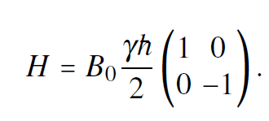
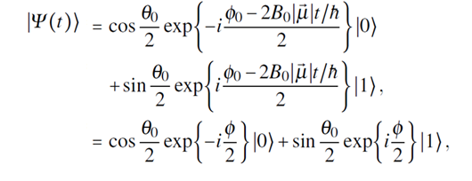
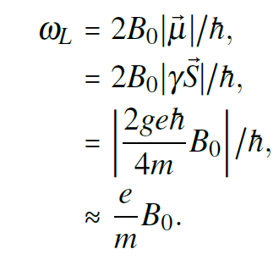
Summary
Hamiltonian of an electron spin under an external magnetic field point down
Larmor Precession
Larmor Precession Frequency
Clockwise precession looking from top

Slide 11
Rabi Oscillations
Chapter 9 of “Quantum Computing Architecture and Hardware for Engineers: Step by Step”
This part has a lot of maths. You only need to be able to understand and derive them open-book (e.g. for assignment). But you need to understand what I am doing.

Slide 12
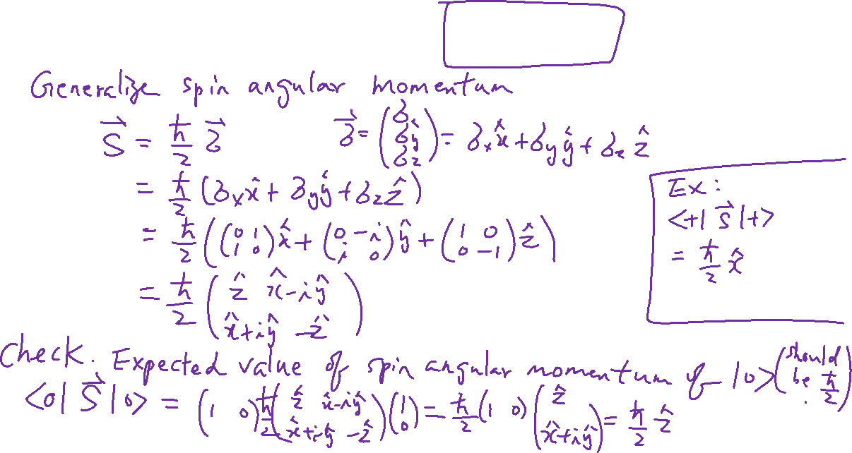
Spin Angular Momentum Operator
Learning outcomes: How to find the spin vector using the Spin operator

Slide 13
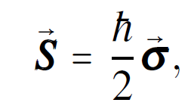
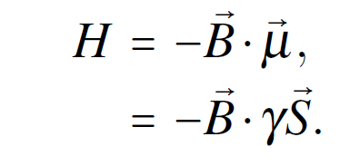
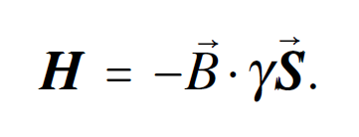
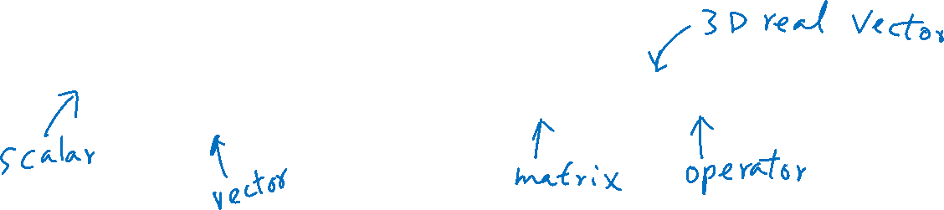
Interaction Hamiltonian

Slide 14
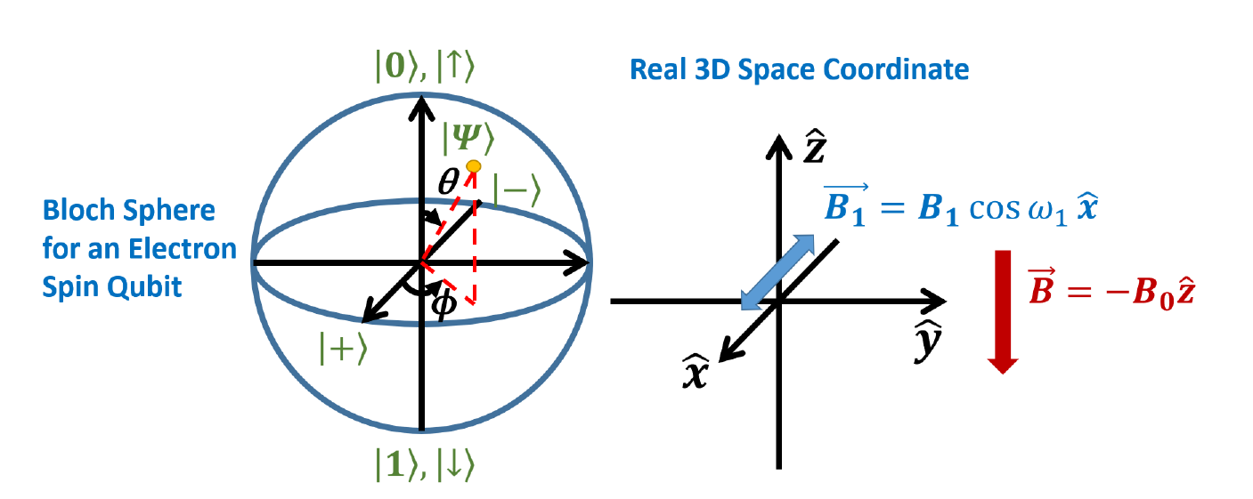
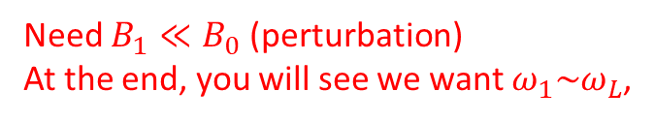
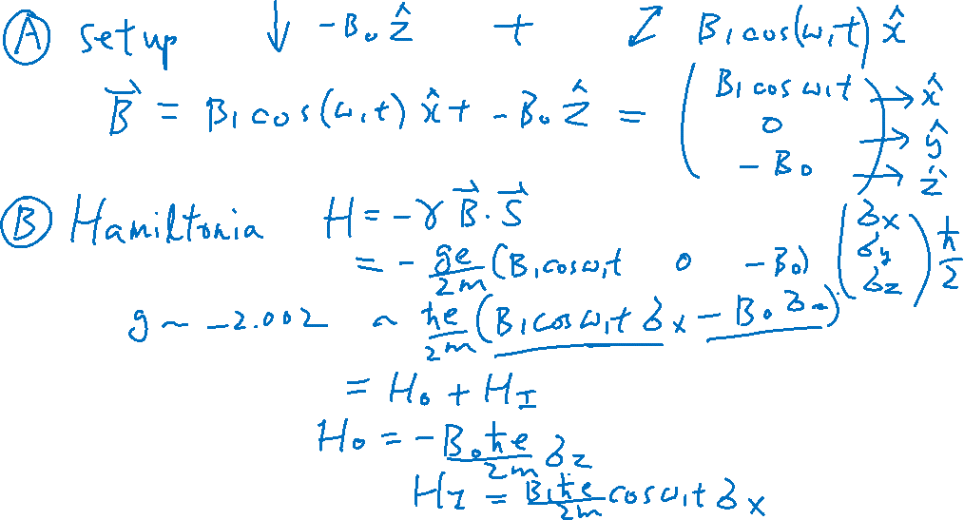
Rabi Oscillation – Experiment Setup
Learning outcomes: Setup
Need $B_{1}≪B_{0}$ (perturbation)
At the end, you will see we want $ω_{1}\sim ω_{L}$,

Slide 15
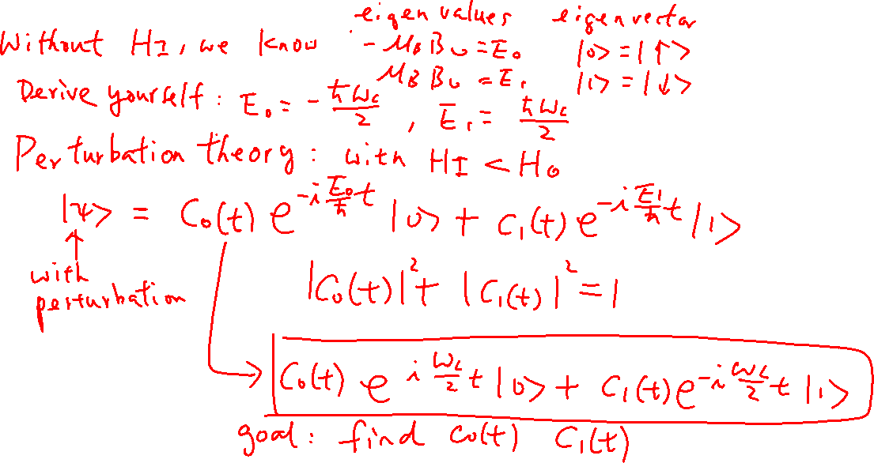
Rabi Oscillation
Learning outcomes: Skill in solving system of differential equations

Slide 16
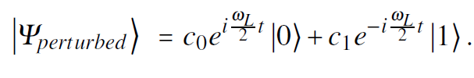
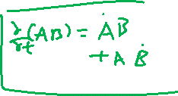
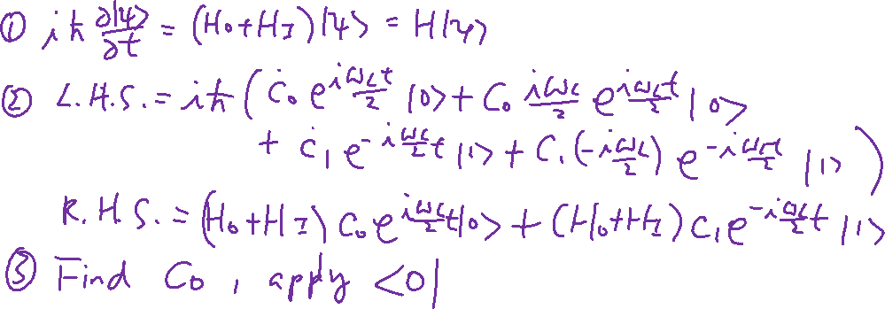
Rabi Oscillation – Solve S.E.
Learning outcomes: Skill in solving system of differential equations

